Slide 1



Case 4
Jack
Familial Hypercholesterolemia

Slide 2

Learning Objectives
Upon completion of this case based session, participants will be able to:
01
Review the diagnostic criteria for Familial Hypercholesterolemia
02
Apply the newly proposed Canadian definition of Familial Hypercholesterolemia
03
Employ evidence-based recommendations to LDL-C targets in this population

Slide 3
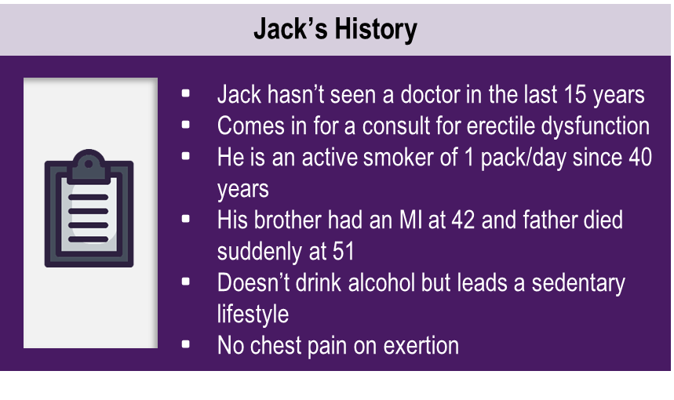
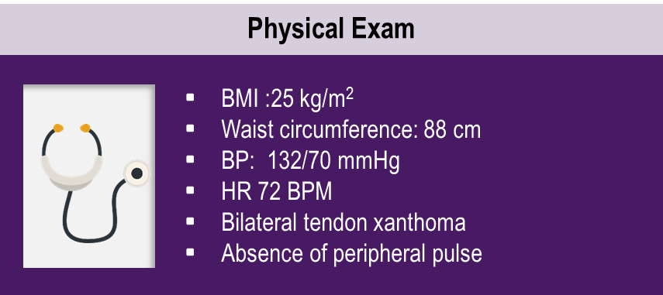

Case 4
Initial Visit
Jack
54 years old

Slide 4
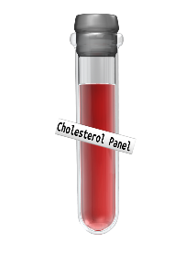

Case 4
Initial Visit
Jack
54 years old
Cholesterol Panel
TC : 11.35 mmol/L
TG : 2.20 mmol/L
LDL-C: 8.72 mmol/L
HDL-C: 1.58 mmol/L
Non-HDL-C: 9.77 mmol/L
T2DM for 8 years
Myocardial Infarction 3 years ago (DES stent)
Hypertension x 10 years
Other Lab Values
LFT: Normal
Creatinine: 82 umol/L
TSH: 2.4 mUI/L
A1C: 5.3%
No proteinuria

Slide 5

Discuss your thoughts on Jack’s case

Slide 6
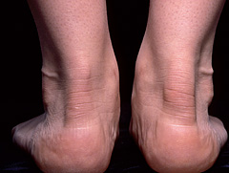
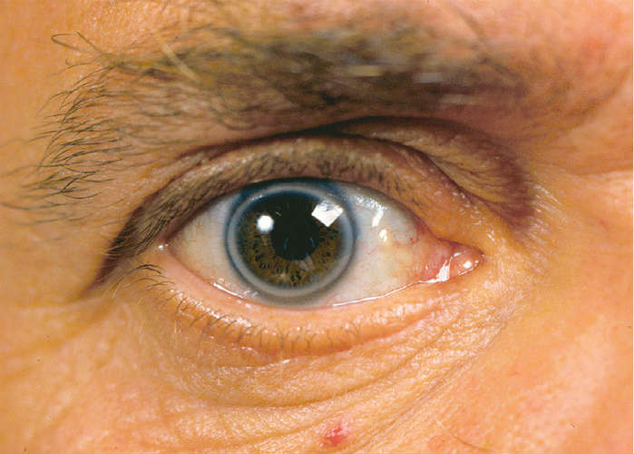

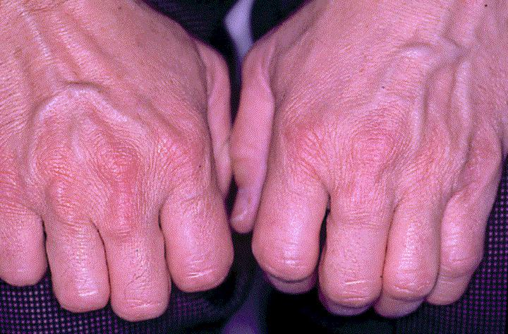

Physical Exam in FH Patient
FH: Familial Hypercholesterolemia
Photos credit: MK, Watts GF. Drugs. 2015;75:1715-24. Morrell JM. Br J Cardiol. 2008;15:79-81; Roshan B, et al. J Clin Lipidol. 2011;5:493-9. Varghese MJ. Ann Pediatr Cardiol. 2014;7:107-17. Yuan G, et al. CMAJ. 2006;174:1124-9.
Notes:
Speaker Notes:
Physical findings (stigmata) in FH. Xanthomas within the Achilles tendons, xanthoma with the extensor tendon of the hand, Bilateral xanthelasma on eyelids, Bilateral arcus corneae, which are pathognomonic when detected by the fifth decade of life, but are nonspecific to FH by the eighth decade of life

Slide 7
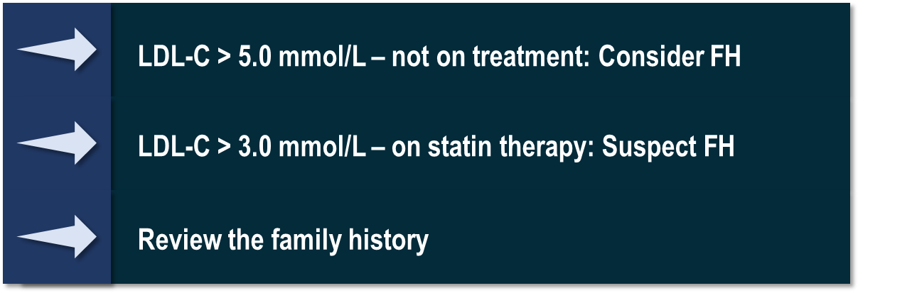
Simon Broome Diagnostic Criteria For Familial Hypercholesterolemia (FH) In Adults
01
A plasma measurement of either:
Total cholesterol > 7.5 mmol/L (adult patient) or > 6.7 mmol/L (child aged < 16 years)
Low-density lipoprotein cholesterol > 4.9 mmol/L (adult patient) or > 4.0 mmol/L (child aged < 16 years)
Definite FH
Possible FH
02
04
PLUS
Tendon xanthomas in the patient or any of the patient’s first- or second degree relatives
PLUS
Family history of myocardial infarction before the age of:
50 Years, in any first- or second-degree relative
60 Years, in any first-degree relative
03
05
OR
DNA-based evidence in the patient of mutation in LDLR or other FH related gene
OR
Family history of plasma total cholesterol > 7.5 mmol/L in any first- or second-degree relative
Genest J. et al, Canadian Cardiovascular Society Position Statement on Familial Hypercholesterolemia Canadian Journal of Cardiology 30 (2014) 1471e1481
Notes:
Speaker Notes:

Slide 8


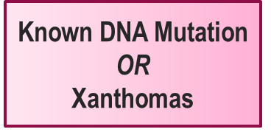



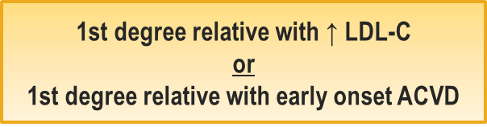


Newly Proposed Canadian Definition Of Familial Hypercholesterolemia (FH) Based On The Simon-Broome Criteria
* Secondary causes ruled out (nephrotic syndrome, obstructive jaundice and hypothyroidism)
Genest J. et al, Canadian Cardiovascular Society Position Statement on Familial Hypercholesterolemia Canadian Journal of Cardiology 30 (2014) 1471e1481
Notes:
Speaker Notes:
Figure 1: Newly proposed Canadian definition of Familial Hypercholesterolemia (FH) based on the Simon-Broome criteria (under discussion)

Slide 9


Familial Hypercholesterolemia Prevalence
FH is one of the most common genetic diseases worldwide
Heterozygote FH
Osteosclerosis
Polycyctic renal disease
Huntington disease
Cystic fibrosis
Marfan syndrome
Duchenne musclular dystrophy
Sickle cell anemia
PKU
Hemophilia
0
1
2
3
4
5
Frequency per 1000 births
1/500 to 1/250 heterozygous
Côte-Nord
1/81
Saguenay Lac St-Jean
1/122
Gaspésie
1/167
In Canada this represents ~140,000 patients !
1/270 heterozygous
Nordestgaard B G et al. Eur Heart J 2013;34:3478-3490
Notes:
Speaker Notes:

Slide 10
Familial Hypercholesterolemia
Most Cases Unrecognized
Estimate of Diagnosis in Canada
15%
Wong et al. BC Med J 2013;55:326-330
Yuan et al. CMAJ 2006;174:1124-9

Slide 11
Untreated FH is Associated with Poor Prognosis
100
80
N = 413
Statin treatment
60
Cumulative Survival Without Coronary Artery Disease (%)
40
N = 1537
No statin treatment
20
0
0
5
10
12.5
Follow-Up (years)
FH: Familial Hypercholesterolemia
Versmissen, et al. BMJ. 2008;337:a2423.
Notes:
Notes:
Kaplan-Meier curve estimates of cumulative coronary heart disease-free survival among patients with familial hypercholesterolaemia according to statin treatment (P<0.001 for difference)
In familial hypercholesterolaemia, the absolute risk of first onset of coronary heart disease was 11/1000 person years in statin treated patients compared with 119/1000 person years in untreated patients. Incident coronary heart disease occurred at younger age in untreated patients (48.6 v 50.9 years, P=0.05). The treated group had a significantly better event-free survival (P<0.001

Slide 12
Homozygous vs Heterozygous FH
Homozygous FH
Heterozygous FH
1 out of 160,000 to 1 million people | 1 out of 250 people
LDL-C > 13 mmol/L | LDL-C > 5 mmol/L
Little or no functional LDL receptors | LDL receptors 2 times less numerous
Plasma LDL-C levels 6 to 10 times higher | Plasma LDL-C levels 2 times higher
Severe and extensive atherosclerosis | Risk of coronary artery disease ~ 20X higher in untreated patients
Frequent cases of heart attack during childhood | 5% of all cases of heart attacks in people <60 years
FH: Familial Hypercholesterolemia
Cuchel M, et al. Eur Heart J. 2014;35:2146-57; Genest J, et al. Can J Cardiol. 2014;30:1471-81. Goldstein JL, Brown MS. Arterioscler Thromb Vasc Biol. 2009;29:431-8. Moorjani S, et al. Arteriosclerosis 1989;9:211-6; Nordestgaard BG, et al. Eur Heart J. 2013;34:3478-90. Vallejo-Vaz AJ, et al. Atherosclerosis. 2015;243:257-9. Watts GF, et al. J Clin Lipidol. 2014;8:148-72.

Slide 13

Jack’s diagnosis has been confirmed as FH.
What would be your initial lipid lowering treatment plan?
Please select from one of the available options
Lifestyle modifications for 3 months
Atorvastatin 20 mg daily
Atorvastatin 80 mg daily
Lifestyle modifications and Atorvastatin 80 mg daily
FH: Familial Hypercholesterolemia

Slide 14
Canadian Cardiovascular Society Pharmacological Treatment Indications and Targets
Category | Consider Initiating pharmaco-therapy if: | Target | NNT
Primary Prevention | High (FRS ≥20%) | LDL-C <2.0 mmol/L or >50% ↓ Or Apo B <0.8 g/L OR non-HDL-C <2.6 mmol/L | 35
 | Intermediate (FRS 10-19%) LDL-C ≥3.5 mmol/L or Non-HDL-C ≥4.3 mmol/L or Apo B ≥1.2 g/L or Men ≥50 and women ≥60 yrs and one additional CVD RF
 |  |  | 40
Statin Indicated Conditions** | Clinical atherosclerosis* |  | 20
 | Abdominal aortic aneurysm
 | Diabetes mellitus ≥40 yrs 15 yrs duration for age ≥30 yrs (DM1) Microvascular disease
 | Chronic kidney disease (age ≥50 y) eGFR <60 mL/min/1.73 m2 or ACR > 3 mg/mmol
 | LDL-C ≥5.0 mmol/L | >50% ↓ in LDL-C
NNT: number needed to treat to prevent one CVD event for 5 years of treatment per 1 mmol/L reduction in LDL-C. NNT of <50 are generally regarded as desirable by physicians with some patients wishing to see NNT <30 to deem an intervention as acceptable.
FRS – modified Framingham Risk Score; ACR – albumin:creatinine ratio;
* consider LDL-C <1.8 mmol/L for subjects with ACS within last 3 months
** statins indicated as initial therapy
Anderson et al. 2016 Canadian Cardiovascular Society Guidelines for the Management of Dyslipidemia for the Prevention of Cardiovascular Disease in the Adult Canadian Journal of Cardiology 2016;32:1263-1282

Slide 15
Higher LDL-C Burden in the FH Patient
Results in Earlier Onset of CHD
Heterozygous FH 35 - Years
Homozygous FH 12.5 Years
Factors Affecting
CHD Threshold
200
Heterozygous FH 48 - Years
Heterozygous FH 53 - Years
Female Gender
THRESHOLD FOR CHD
150
START HIGH DOSE STATIN
Smoking
Hypertension
Diabetes
Triglycerides
HDL-C
Lipoprotein(a)
Without FH 55 - Years
100
START LOW DOSE STATIN
Cumulative LDL-C (mmoL)
50
0
0
3
6
9
12
15
18
21
24
27
30
33
36
39
42
45
48
51
54
57
60
Age in Years
FH: Familial Hypercholesterolemia
The Author 2013. Published by Oxford University Press on behalf of the European Society of Cardiology.
Adapted from: Nordestgaard BG, et al. Eur Heart J. 2013;34:3478-3490.
Notes:
Speaker Notes:
Factors Affecting CHD Threshold
LDL cholesterol burden in individuals with or without familial hypercholesterolaemia as a function of the age of initiation of statin therapy.
It should be stressed that risk calculators such as the European SCORE or the US Framingham Risk Score are not appropriate for FH subjects, as such individuals are at considerably higher risk due to lifelong elevated LDL cholesterol levels (Figure 8). Nevertheless, whether diagnosed clinically or through a causative mutation, not all individuals with FH develop atherosclerosis and CHD to the same extent. Thus, as observed for the development of any CHD,²⁵ other risk factors besides elevated LDL cholesterol act to determine the threshold for CHD (Figure 8), and risk factor counting is critical to assess CHD risk.²⁶ Importantly, as elevated LDL cholesterol is the major problem in FH, this condition is dominated by CHD, whereas cerebrovascular disease is more common in individuals with hypertension and atherosclerosis in the lower limbs is more common among smokers.
The concept of a cumulative LDL cholesterol burden (Figure 8) illustrates the importance of early treatment. The cumulative LDL cholesterol burden of a 55-year-old person without FH is typically 160 mmol, a burden sufficient for CHD to develop (Figure 8; data derived from^{20,21}). For an individual with heterozygous FH, this LDL cholesterol burden is reached by age 35 if untreated, by age 48 if treated since age 18, and by age 53 if treated since age 10. An untreated subject with homozygous FH will reach this level at age 12.5.
Men develop CHD before women; furthermore, hypertension, smoking, diabetes, and high triglycerides/low HDL cholesterol²⁴ are all well-established additional risk factors in FH. In addition, lipoprotein(a) [Lp(a)] may be particularly elevated in clinically diagnosed heterozygous or homozygous FH.^{27,28} Indeed, elevated Lp(a) is now a well-established causal risk factor for cardiovascular disease irrespective of LDL cholesterol concentration.^{29,30} Elevated Lp(a) is also an important cardiovascular risk factor in FH.³¹ Because elevated Lp(a) significantly enhances risk of premature cardiovascular disease in those already at extremely high risk due to FH, additional, aggressive LDL lowering with statins and other drugs should be initiated in FH individuals with high levels of Lp(a). In such individuals, and in extreme cases with severe atherosclerosis and/or CHD, lipoprotein apheresis should be considered.^{32,33}
Reference:
Huijgen et al. and Starr et al. LDL = low-density lipoprotein; LDL-C = LDL cholesterol; HDL-C = high-density lipoprotein cholesterol; CHD = coronary heart disease; FH = familial hypercholesterolaemia.

Slide 16

Case 4
Visit 2 - 3 months follow-up
Jack
54 years old
You prescribed atorvastatin 80 mg plus lifestyle modifications
to Jack 3 months ago and he returns for a follow-up appointment
His most recent LDL-C is 4.01 mmol/L
Initial Visit LDL-C: 8.72 mmol/L

Slide 17
What would be your next management step for Jack’s LDL-C?
Please select from one of the available options
No change
Switch to Rosuvastatin 40 mg/day
Add Ezetimibe 10 mg to Atorvastatin 80 mg/day
Add a PCSK9 inhibitor
FH: Familial Hypercholesterolemia

Slide 18

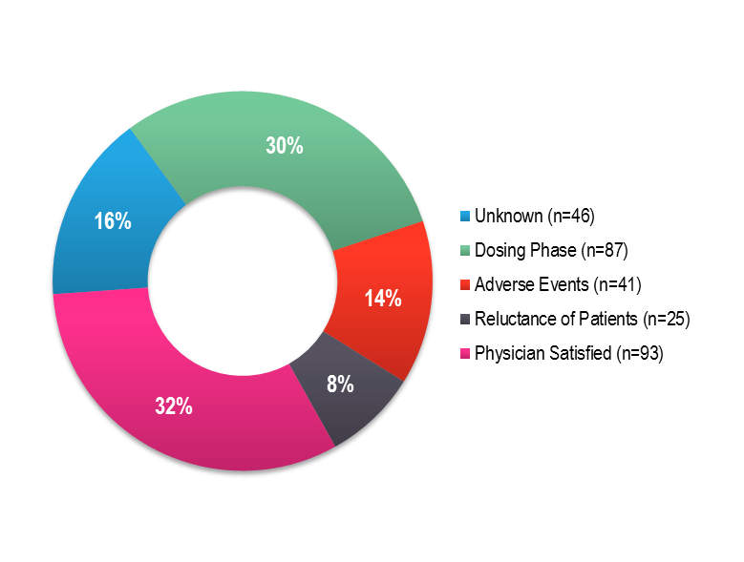
There Is a Need for More Robust
Lipid Lowering in HeFH
Netherlands study of 1,249 patients with HeFH
96% were on statins
79% of these did not achieve LDL-C target of < 2.5 mmol/L
Only 27% were using maximum therapy*
47% of patients achieved 50% LDL-C reduction but were still ≥ 2.5 mmol/L
Maximum lipid-lowering therapy is defined as maximum statin dose in combination with ezetimibe.
The mean LDL-C for all patients was 3.2 ± 1.1 mmol/L.
HeFH: Heterozygous Familial Hypercholesterolemia
Pijlman AH, et al. Atherosclerosis. 2010;209;189–194.

Slide 19
Case 4
Visit 3 - 3 months follow-up
Jack
54 years old
You added ezetimibe 10 mg
to atorvastatin 80 mg
at Jack’s previous visit.
Jack comes in for his follow-up appointment after 3 months.
His most recent LDL-C is 3.2 mmol/L
Visit 2 LDL-C: 4.01 mmol/L
Initial Visit LDL-C: 8.72 mmol/L
You decide to prescribe Evolocumab 140mg SC q 2 w

Slide 20
What effect on Jack’s LDL-C do you expect with the addition of Evolocumab ?

Slide 21
RUTHERFORD-2: Significant Reduction Of LDL-C with Evolocumab in Patients with Heterozygous FH
Placebo Q2W (n = 54)
20
Evolocumab 140mg Q2W (n = 110)
0
-1 %
-20
Mean change in LDL-C from baseline (%)
60 % vs placebo
-40
-60
- 61 %
-80
Baseline
2
8
10
12
Week
FH: Familial Hypercholesterolemia
Raal, et al. Lancet. 2015;385:331-40.
Notes:
Speaker Notes:
Methods
This multicentre, randomised, double-blind, placebo-controlled trial was undertaken at 39 sites (most of which were specialised lipid clinics, mainly attached to academic institutions) in Australia, Asia, Europe, New Zealand, North America, and South Africa between Feb 7 and Dec 19, 2013. 331 eligible patients (18–80 years of age), who met clinical criteria for heterozygous familial hypercholesterolaemia and were on stable lipid-lowering therapy for at least 4 weeks, with a fasting LDL cholesterol concentration of 2·6 mmol/L or higher, were randomly allocated in a 2:2:1:1 ratio to receive subcutaneous evolocumab 140 mg every 2 weeks, evolocumab 420 mg monthly, or subcutaneous placebo every 2 weeks or monthly for 12 weeks. Randomisation was computer generated by the study sponsor, implemented by a computerised voice interactive system, and stratified by LDL cholesterol concentration at screening (higher or lower than 4·1 mmol/L) and by baseline ezetimibe use (yes/no). Patients, study personnel, investigators, and Amgen study staff were masked to treatment assignments within dosing frequency groups. The coprimary endpoints were percentage change from baseline in LDL cholesterol at week 12 and at the mean of weeks 10 and 12, analysed by intention-to-treat. This trial is registered with ClinicalTrials.gov, number NCT01763918.
Findings
Of 415 screened patients, 331 were eligible and were randomly assigned to the four treatment groups: evolocumab 140 mg every 2 weeks (n=111), evolocumab 420 mg monthly (n=110), placebo every 2 weeks (n=55), or placebo monthly (n=55). 329 patients received at least one dose of study drug. Compared with placebo, evolocumab at both dosing schedules led to a significant reduction in mean LDL cholesterol at week 12 (every-2-weeks dose: 59·2% reduction [95% CI 53·4–65·1], monthly dose: 61·3% reduction [53·6–69·0]; both p<0·0001) and at the mean of weeks 10 and 12 (60·2% reduction [95% CI 54·5–65·8] and 65·6% reduction [59·8–71·3]; both p<0·0001). Evolocumab was well tolerated, with rates of adverse events similar to placebo. The most common adverse events occurring more frequently in the evolocumab-treated patients than in the placebo groups were nasopharyngitis (in 19 patients [9%] vs five [5%] in the placebo group) and muscle-related adverse events (ten patients [5%] vs 1 [1%]).
Interpretation
In patients with heterozygous familial hypercholesterolaemia, evolocumab administered either 140 mg every 2 weeks or 420 mg monthly was well tolerated and yielded similar and rapid 60% reductions in LDL cholesterol compared with placebo.

Slide 22
ODYSSEY FH I & ODYSSEY FH II :
Alirocumab Significantly Reduced LDL-C from Baseline to
Week 24 versus Placebo
All patients were treated with a statin at the maximum tolerated dose
± another lipid-lowering agent
FH I
Alirocumab
FH II
9,1 %
Placebo
2,8 %
N = 322
N = 163
N = 166
N = 81
LS mean (SE) % change from baselne to Week 24
-48,8 %
-48,7 %
LS mean difference (SE) vs. placebo:
−57.9% (2.7)
P<0.0001
−51.4% (3.4)
P<0.0001
FH: Familial Hypercholesterolemia
Kastelein JJ et al; Eur Heart J. 2015 Nov 14;36(43):2996-3003.
Notes:
Speaker Notes:
METHODS AND RESULTS:
In two randomized, double-blind studies (ODYSSEY FH I, n = 486; FH II, n = 249), patients were randomized 2 : 1 to alirocumab 75 mg or placebo every 2 weeks (Q2W). Alirocumab dose was increased at Week 12 to 150 mg Q2W if Week 8 LDL-C was ≥1.8 mmol/L (70 mg/dL). Primary endpoint (both studies) was percentage change in calculated LDL-C from baseline to Week 24. Mean LDL-C levels decreased from 3.7 mmol/L (144.7 mg/dL) at baseline to 1.8 mmol/L (71.3 mg/dL; -57.9% vs. placebo) at Week 24 in patients randomized to alirocumab in FH I and from 3.5 mmol/L (134.6 mg/dL) to 1.8 mmol/L (67.7 mg/dL; -51.4% vs. placebo) in FH II (P < 0.0001). These reductions were maintained through Week 78. LDL-C <1.8 mmol/L (regardless of cardiovascular risk) was achieved at Week 24 by 59.8 and 68.2% of alirocumab-treated patients in FH I and FH II, respectively. Adverse events resulted in discontinuation in 3.4% of alirocumab-treated patients in FH I (vs. 6.1% placebo) and 3.6% (vs. 1.2%) in FH II. Rate of injection site reactions in alirocumab-treated patients was 12.4% in FH I and 11.4% in FH II (vs. 11.0 and 7.4% with placebo).
CONCLUSION:
In patients with HeFH and inadequate LDL-C control at baseline despite maximally tolerated statin ± other LLT, alirocumab treatment resulted in significant LDL-C lowering and greater achievement of LDL-C target levels and was well tolerated.
CLINICAL TRIAL REGISTRATION:
Cinicaltrials.gov (identifiers: NCT01623115; NCT01709500).

Slide 23
Case 4
Visit 4 - 3 months follow-up
Jack
54 years old
Jack’s Lipid Lowering Therapy
Atorvastatin 80 mg
Ezetimibe 10 mg
Evolocumab 140mg SC q 2 w
His most recent LDL-C is 1.12 mmol/L
Visit 3 LDL-C: 3.2 mmol/L
Visit 2 LDL-C: 4.01 mmol/L
Initial Visit LDL-C: 8.72 mmol/L

Slide 24
Is there anything else you need to do with respect to Jack’s LDL-C management at this point?

Slide 25
Importance of Cascade Screening in FH
The presence of high cholesterol and early onset of coronary heart disease in some immediate family members* are strong indicators of FH
Man
Woman
FH
Index case: start of cascade screening
Importance of cascade screening
Half of 1st degree relatives share the same genetic defect
Cascade screening is the most effective way to detect FH
The starting point is a patient with FH and examination of his siblings, parents and children
If a new case is identified, 1st degree parents, siblings and children should be tested
Death 76 yrs
No CHD
LDL-C 3.8 mmol/L
Age 78 yrs
CHD 58 yrs
LDL-C 7.4 mmol/L
FH
Age 50 yrs
No CHD
LDL-C 3.3 mmol/L
Age 48 yrs
CHD 48 yrs
LDL-C 8.3 mmol/L
Age 47 yrs
No CHD
LDL-C 2.4 mmol/L
FH
FH
Age 18 yrs
LDL-C 2.2 mmol/L
Age 15 yrs
LDL-C 6.1 mmol/L
Age 8 yrs
LDL-C 5.6 mmol/L
FH: Familial Hypercholesterolemia
* Parents, siblings and children
Nordestgaard et al. Eur Heart J 2013; 34: 3478-3490
Notes:
Jack’s age is 54 – can be applied to patient in this case

Slide 26
Summary
Most FH cases are unrecognized
A systematic approach should be used to detect the FH patient
A robust lipid lowering treatment plan is required, including the addition of a PCSK9 inhibitor, to achieve the LDL-C target in this population
Notes:
Notes

